Slide 1
Lab 9

Slide 2
Objectives
Learn about the Role definition for UserAccount
Learn about the Work Request flow

Slide 3
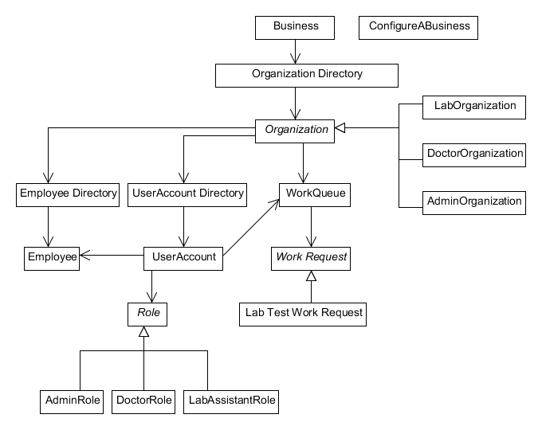
Architecture

Slide 4
Steps
Admin Role
1. Admin creates a Lab and Doctor Organization
2. Admin Role adds users of Doctor and Lab.
3. Admin creates doctor and lab employee's
4. Admin Provides username and password for doctor and lab employee's
Doctor Role
1. Doctor login
2. Doctor request for the test(Initiate work request)
3. Doctor submits the request
Lab Role
1. Lab Assistant Login
2. Lab Assistant processes the request which was submitted by the Doctor
3. Lab Assistant assigns the work request to itself
4. Lab Assistant process the request and submit back the request.

Slide 5
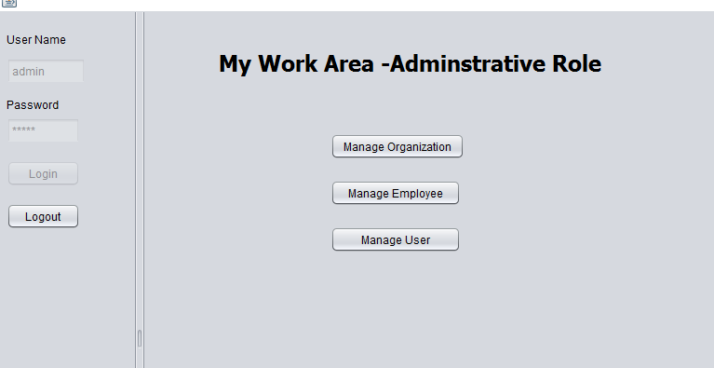
Admin Role

Slide 6
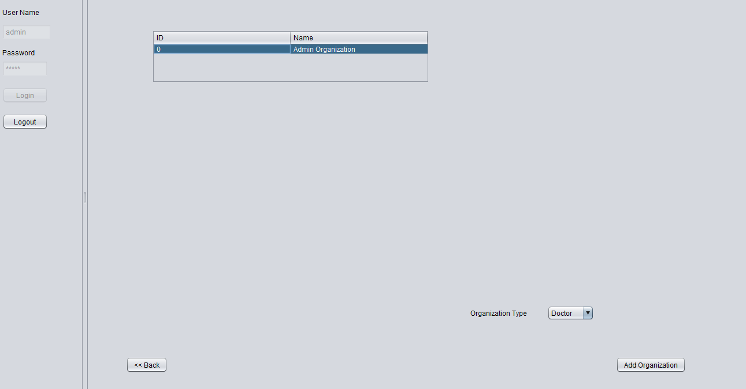
Admin Role- Manage Organization

Slide 7
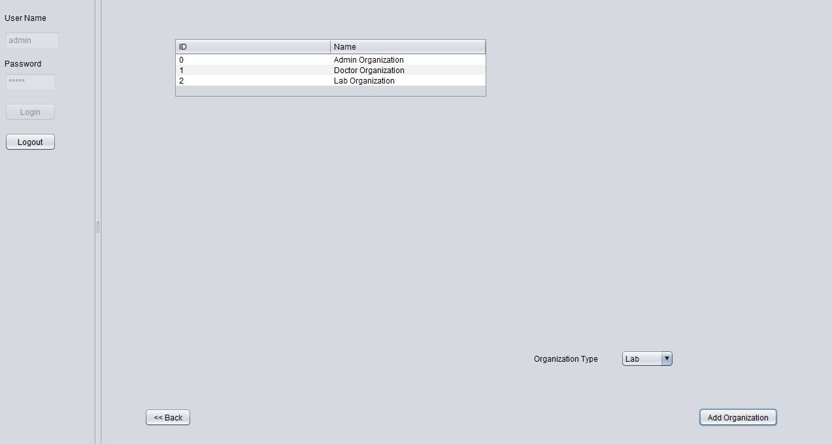
Admin Role- Manage Organization

Slide 8
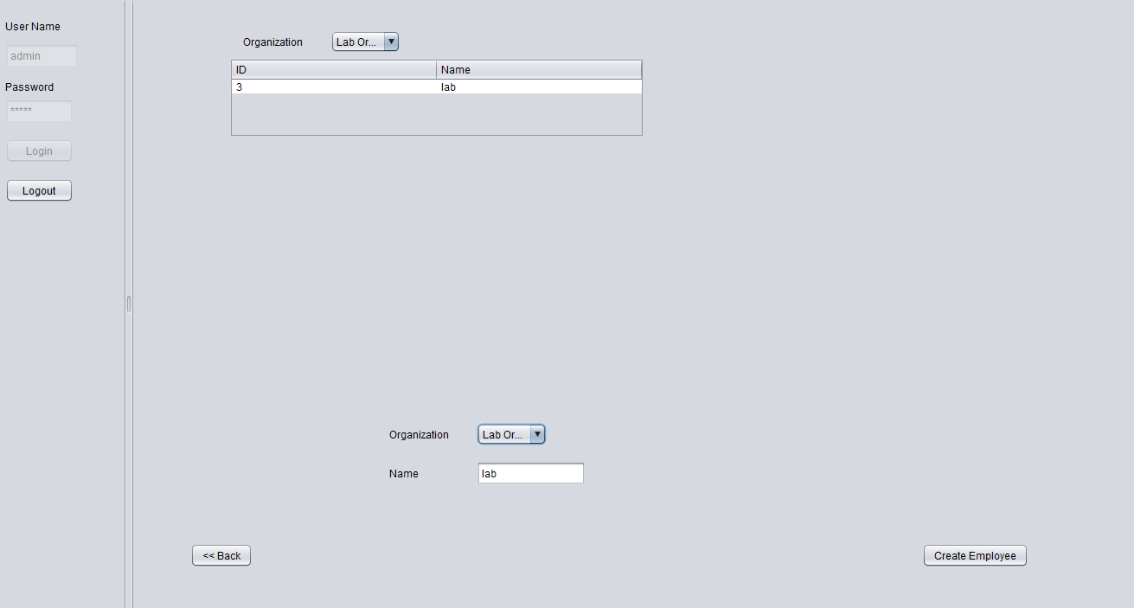
Admin Role- Manage Employees

Slide 9
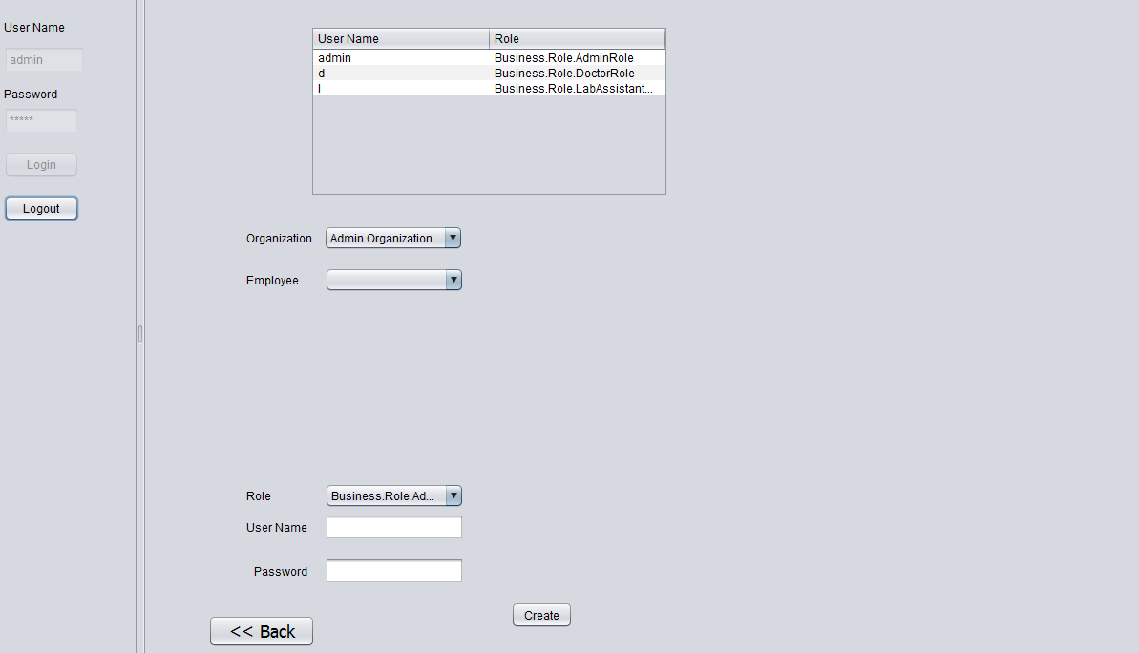
Admin Role- Manage Users

Slide 10
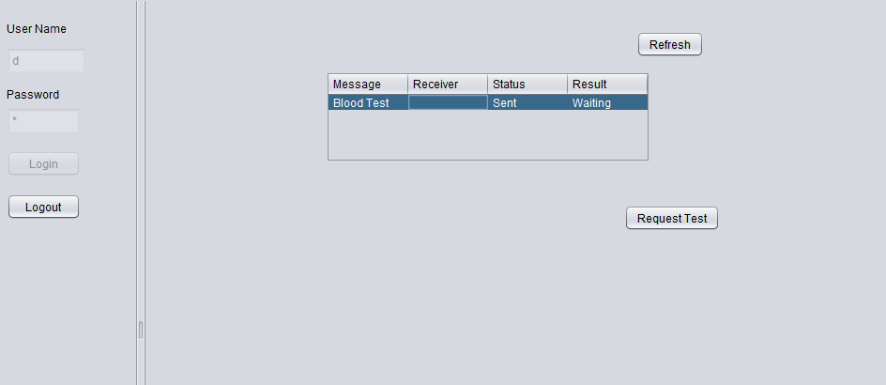
Doctor Role-Request Test

Slide 11
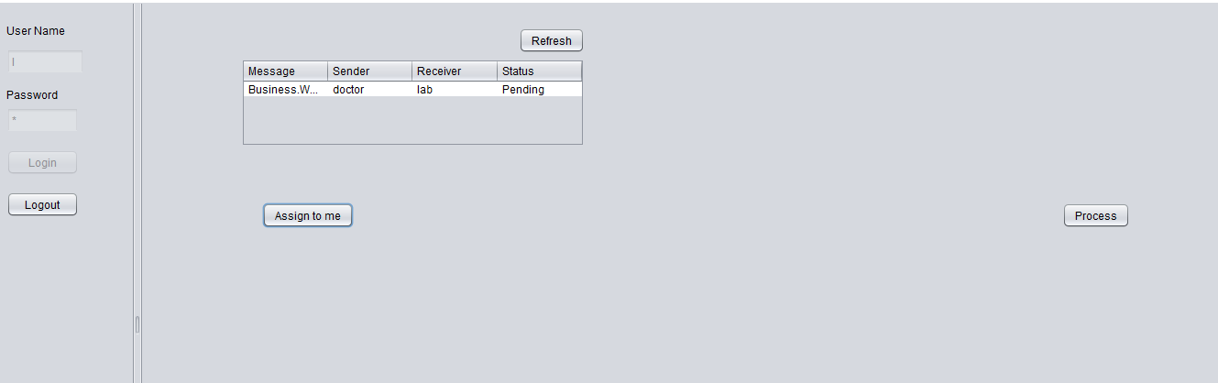
Lab Role-Assign to me

Slide 12
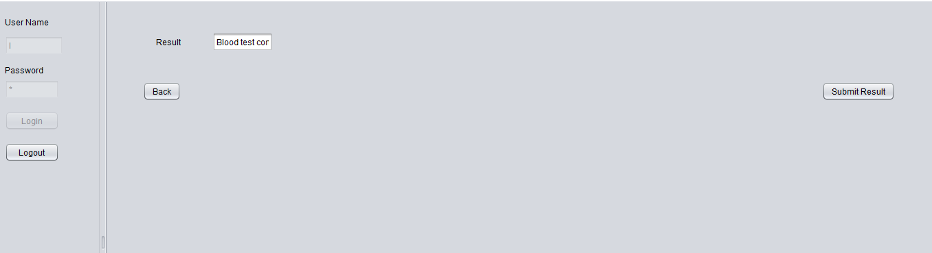
Lab Role-Process Request

Slide 13
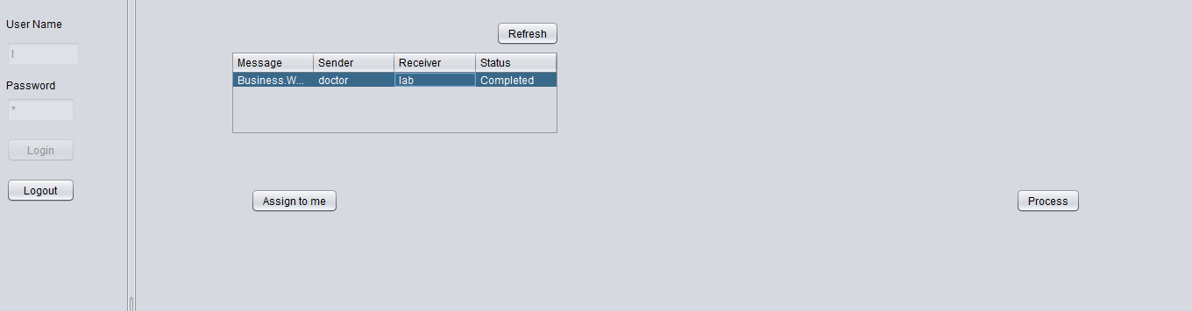
Lab Role-Process request complete

Slide 14
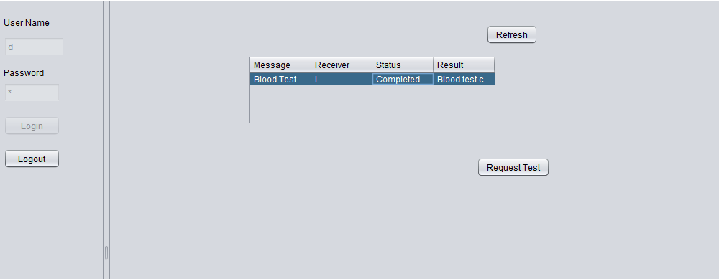
Doctor Role- Process Complete

Slide 15
Enum in Java
An enum type is a special data type that enables for a variable to be a set of predefined constants. The variable must be equal to one of the values that have been predefined for it. Common examples include compass directions (values of NORTH, SOUTH, EAST, and WEST) and the days of the week.
In Java, we can also add variables, methods and constructors to it. The main objective of enum is to define our own data types(Enumerated Data Types).
https://docs.oracle.com/javase/tutorial/java/javaOO/enum.html

